Slide 1


Slide 2


Employee Retention Prediction
This project focuses on predicting whether an employee will stay with their company or leave. The goal is to understand the factors influencing this decision, such as the employee's experience, education, and the size of the company.
By predicting potential turnover, companies can take steps to retain valuable employees and reduce the costs associated with hiring new staff.

Slide 3


Objective
1
Dataset Information
2
Exploratory Data Analysis (EDA)
Describe the dataset, including the number of records and features, and explain what each feature represents. Identify any missing values or irrelevant features that need to be addressed.
Analyze the dataset to find patterns and relationships between features. Visualize key variables to understand their distribution and how they might impact employee retention.
3
Model Building
4
Compare Models
Create and train different machine learning models (like, Decision Tree, Random Forest, Logistic Regression.) to predict whether an employee will leave the company.
Test each model's performance and compare their accuracy, precision, and recall. Choose the best model for predicting employee turnover.

Slide 4
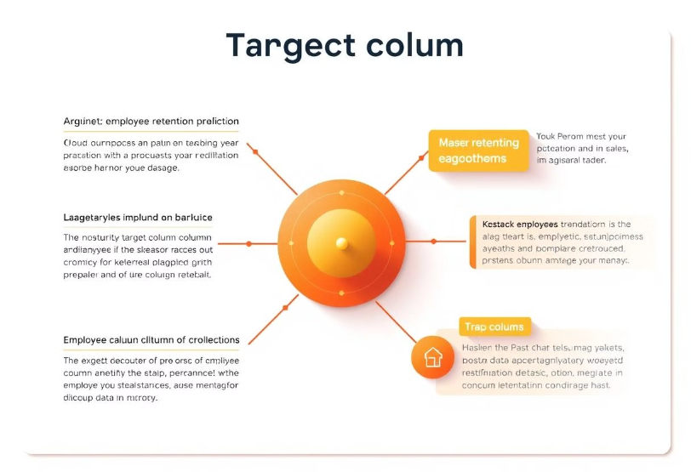
Use and Purpose
Use: The "target" column is used during the training phase of your machine learning model. The model learns patterns in the data that help it predict the value of the target variable based on other features (like experience, education level, etc.).
Purpose: The purpose of this column is to provide the ground truth labels for supervised learning. The model will compare its predictions against these labels during training to improve its accuracy in predicting whether a data scientist is likely to leave the job.

Slide 5
Exploratory Data Analysis (EDA)
Exploratory Data Analysis (EDA) helped us understand the data structure, find patterns, identify trends, and gain valuable insights from the dataset.
From EDA we analyze, the distribution of each features, checking the correlation between the features .
Using visuals helped us see the data clearly, understand the clinical data relationship with each other, and pinpoint factors that plays vital role in predictions of heart disease.
The datasets is clean ,as there is no null value, but we can find some duplicate value and outliers.
My dataset include 3 as numerical feature, representing continuous values like development index scores, the number of training hours, and the target variable.
The categorical features include 3 column among others, which categorize data into distinct groups,such as different cities, gender types, and levels of education.

Slide 6
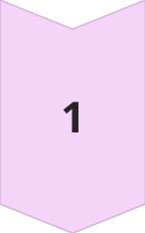
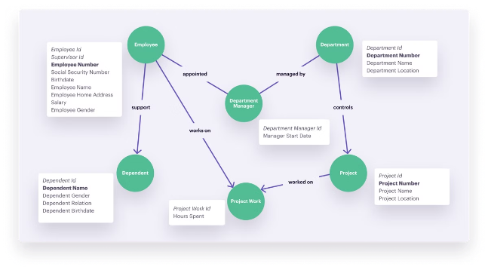
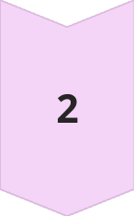
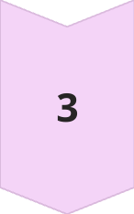
Predictive Models for Retention
Decision Trees
Decision trees use a series of rules to classify employees as likely to stay or leave.
Random Forests
Random forests combine multiple decision trees to improve prediction accuracy.
Logistic Regression
Linear or logistic regression models can predict the probability of an employee leaving based on various factors.

Slide 7

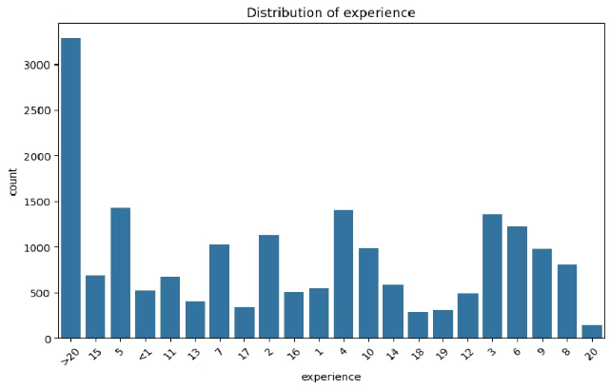
Sub Plot
The graph shows a bar chart representing the frequency of each experience level in the dataset.
Each bar corresponds to an experience category (like '2 years', '5 years', etc.), and its height indicates how often that experience level appears.
The x-axis shows the experience levels, and the y-axis shows the count. The labels are rotated for better readability, and the layout is neatly organized without overlapping elements.

Slide 8

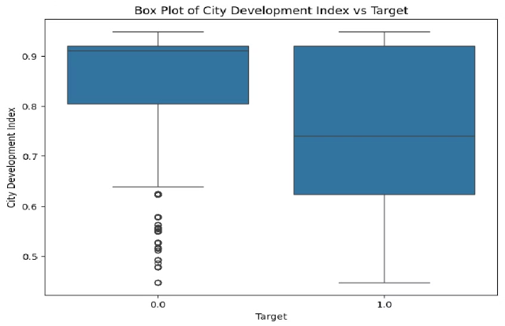
Box Plot
The graph shows a box plot comparing 'City Development Index' with 'Target'.
Each box represents the distribution of 'City Development Index' values for different 'Target' categories.
The plot reveals the median, quartiles, and potential outliers in 'City Development Index' for each 'Target' group.
The x-axis labels 'Target' categories, while the y-axis displays 'City Development Index' values.

Slide 9
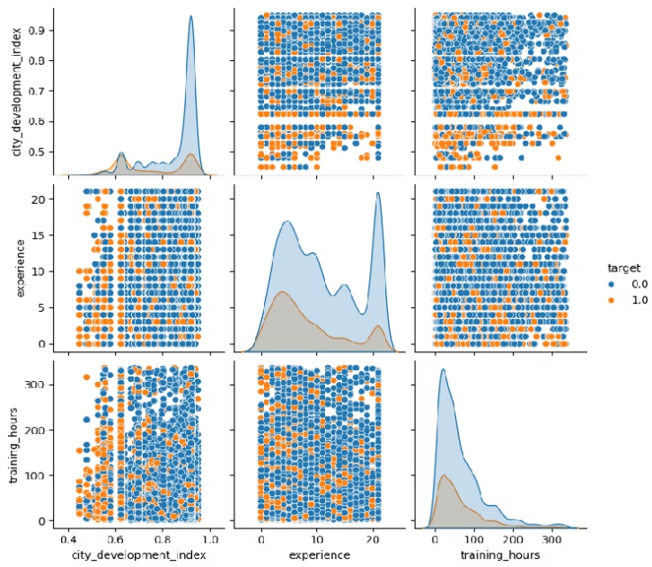
Pair Plot
The pair plot visualizes the relationships between ‘city_development_index’, ‘experience’, ‘training_hours’ with respect to the target variable.
Each point represents an individual in the dataset, colored by their target outcome.
The diagonal plots show the distribution of each numerical feature, while the off-diagonal plots reveal how these features interact with each other and the target variable.

Slide 10
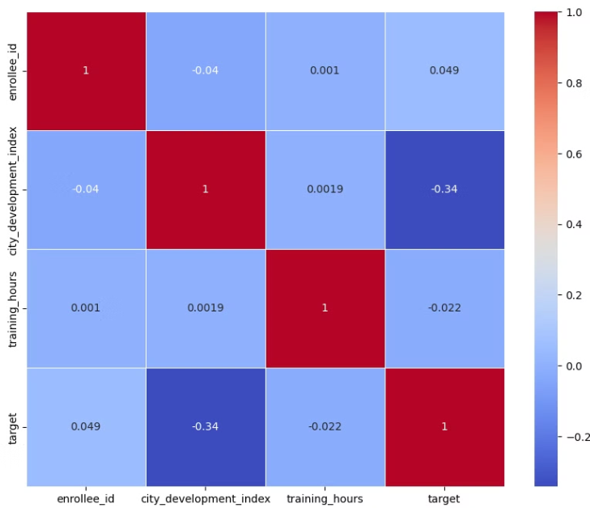
Heatmap
This heatmap shows the correlation between different numerical features in our dataset. A value close to 1 indicates a strong positive correlation, while a value close to -1 indicates a strong negative correlation.
We can see that 'city_development_index' has a moderate negative correlation with the 'target', indicating that higher development index values might be associated with a lower likelihood of a positive target outcome.
Other features show weak correlations with each other and the target.

Slide 11
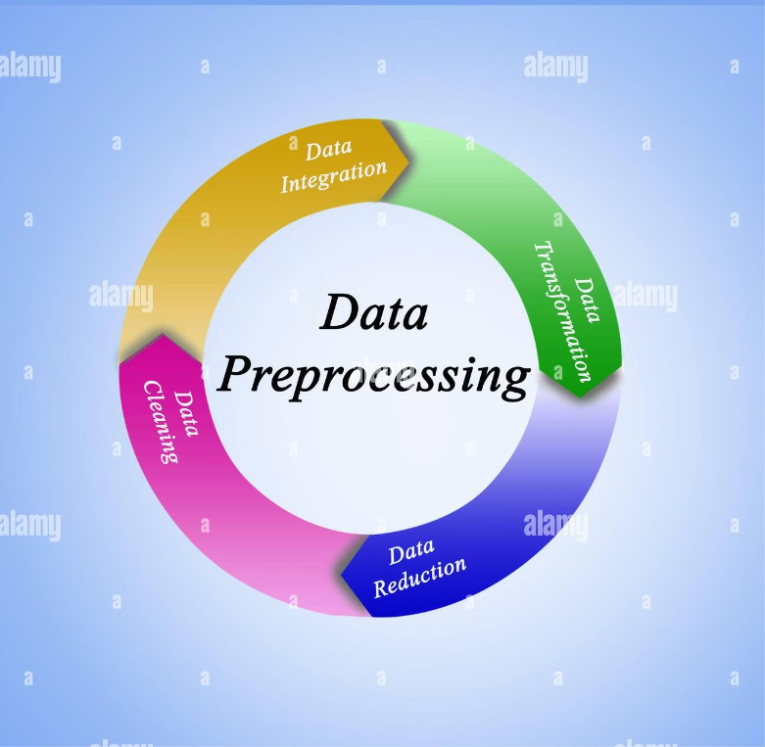
PREPROCESSSING
Irrelevant Features Removal : In this project, I removed irrelevant features such as 'enrollee_id', which serves only as an identifier, and other columns with high missing values like 'company_size' and 'company_type'. This process enhances model performance by reducing noise and focusing on the most informative features.
Missing Value Treatment : Missing data can skew analysis or lead to inaccurate predictions. To address this, we fill missing values with appropriate substitutes instead of dropping them, ensuring the dataset remains complete.
Categorical Features Encoding : Label Encoding converts categorical (text) data into numerical values so that machine learning models can process it.

Slide 12
Train Test Split
We divided the data into training (80%) and testing (20%) sets.
Setting a random state ensures consistent results and using stratify=y maintains a proportional distribution of the target variable in both sets.
Splitting The Data Into X & Y
We divided the dataset into two parts : X and y.
"X" typically represents the independent variables, and "y" represents the Dependent (target variable) that we want to predict or understand.

Slide 13
Model Selection
Decision Tree : A Decision Tree model predicts outcomes by splitting data into branches based on feature values, like a flowchart. It’s easy to understand because it visually represents the decision-making process, helping identify key factors that influence whether an employee might leave the company.
Random Forest : The Random Forest model builds multiple decision trees using different parts of the data and then combines their predictions to make a final decision.
Logistic Regression : Logistic regression is a type of statistical model used to predict the probability of a binary outcome based on one or more input features. It calculates the likelihood of the outcome using a logistic function, which ensures the result is between 0 and 1, making it suitable for classification tasks.

Slide 14
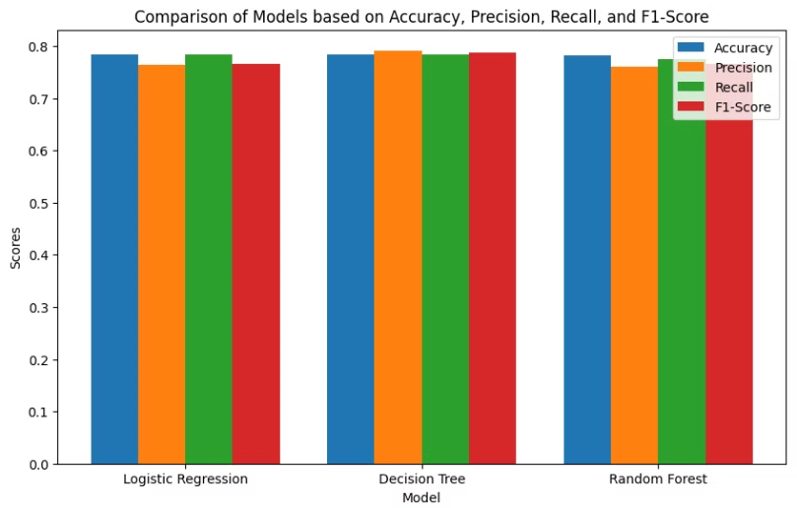
Model
Accuracy
Precision
Recall
F1-Score
Logistic Regression
0.7831
0.7639
0.7831
0.7661
Decision Tree
0.7829
0.7914
0.7829
0.7865
Random Forest
0.7811
0.7606
0.7745
0.7652
Accuracy : Logistic Regression has the highest accuracy at 0.7831, slightly outperforming Decision Tree (0.7829) and Random Forest (0.7811).
Precision : The Decision Tree model has the highest precision at 0.7914, indicating it is better at avoiding false positives compared to Logistic Regression (0.7639) and Random Forest (0.7606).
Recall : Logistic Regression leads in recall with 0.7831, meaning it correctly identifies positive cases more often than Decision Tree (0.7829) and Random Forest (0.7745).
F1-Score : The Decision Tree model has the highest F1-Score at 0.7865, suggesting a better overall balance between precision and recall compared to Logistic Regression (0.7661) and Random Forest (0.7652).

Slide 15


Conclusion
The Logistic Regression model outperformed other models in predicting employee retention with the highest accuracy. This indicates its superior capability in forecasting whether employees might change jobs. Thus, Logistic Regression is the most effective model for this task, providing valuable insights for improving employee retention and optimizing workforce management strategies.

Slide 16
Thank You !

